Slide 1
Virtual Display Design System
Akshar Prabhu Desai (09305909)
Guide: Dr. Kavi Arya
3/5/11
R&D Project

Slide 2
Objectives
Parameterized geometry specification in XML
Parser which generates openGL code from the XML.
Hooks to pull data from the core system
Exploring possibilities to integrate input devices with the display.

Slide 3
The Display
Display is a combination of parameterized basic geometric shapes.
The values of parameters come from the core system or they are constants.

Slide 4
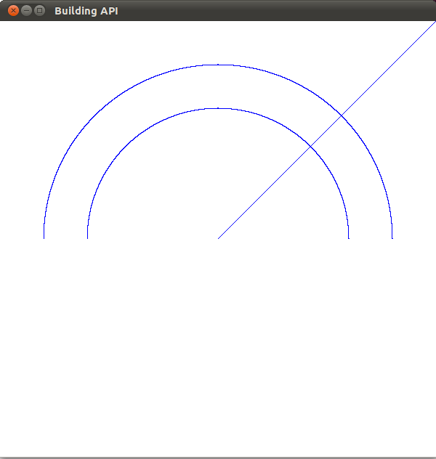
Example
<layer depth="0.0“ >
<object xtype="arc"
center="point1" radius="length1" startAngle="angle1“ endAngle="angle2"></object>
<object id="point1" x="0.0" y="0.0"></object >
<object id="length1" value="0.6"></object >
<object id="angle1" value="0"></object >
<object id="angle2" value="180"></object>
</layer>

Slide 5
Hooks
Hooks are used to pull the parameters from the core system, or for simulation.
There is a separate Hook description.
<hooks>
<hook for="point1" param="x" function="get_robot_location_x"></hook>
<hook for="point1" param="y" function="get_robot_location_y"></hook>
<hook for="point1" param="radius" function="get_robot_radar"></hook>
</hooks>
The hooks may have additional parameters such a return type, range of values and so on.

Slide 6
Features
All display parameters are “pulled” from the core system
All layers are rendered with same priority
Everything is refreshed every frame.

Slide 7
Simulation
Planning to add simulation features.
User will provide the range of values which the different hooks can take and the displays will be simulated for values across that range.

Slide 8
Path ahead
Adding input capabilities to a design through keys, touch etc.
Input handling requires assumptions about the hardware
There is a trade-off between building a decoupled general purpose display design system and making assumptions about the hardware.

Slide 9
Summary
So far there is no ‘real-time’ issues I am looking at
I am not able to visualize such issues at this stage
So far it has been only about coding a code generator
Hopefully when I build some displays and integrate them with some hardware will have more clarity

